Slide 1

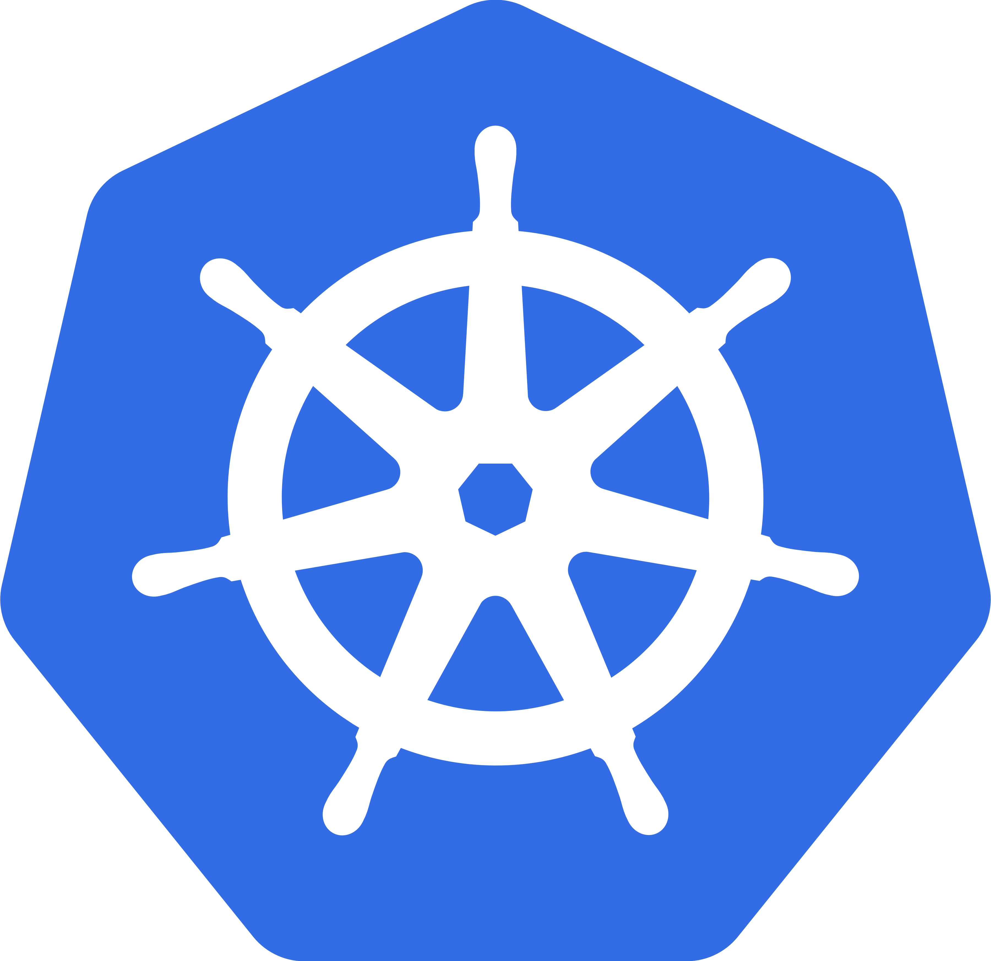
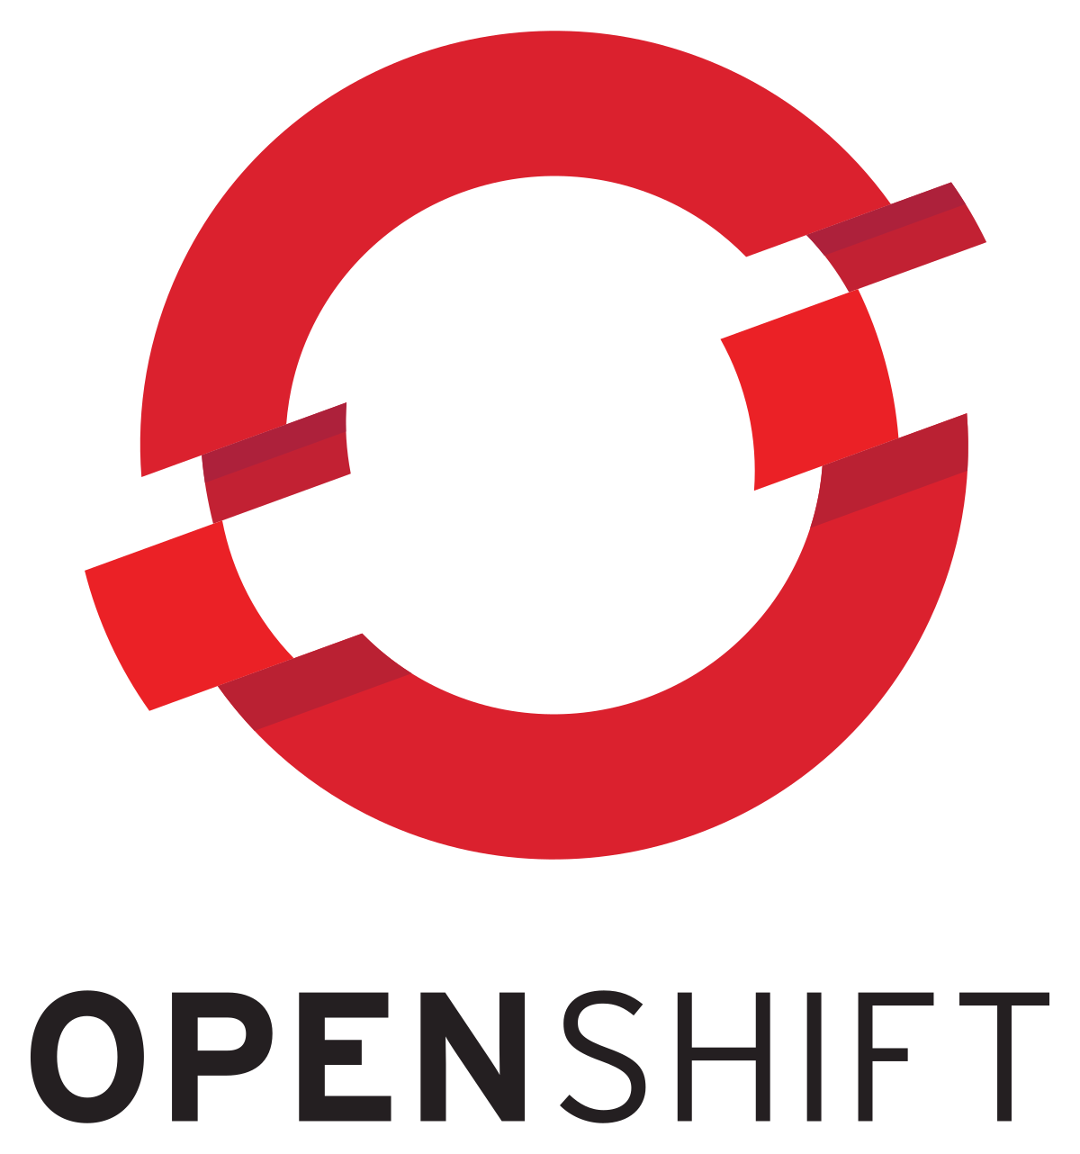

Container Management and Orchestration Platforms
By Shreyas B Rao

Slide 2

INTRODUCTION
Hi, I’m Shreyas B Rao, Intern at NTT Ltd. I am currently doing my second year Computer Science engineering in Jain University (FETJU). I am a Techie as well as an aspiring musician. Aim to be productive.

Slide 3
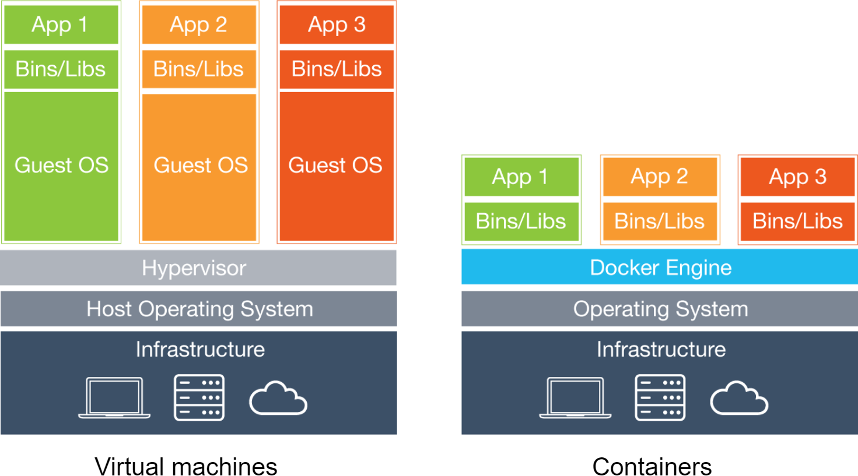
Containerization
Why do we use containers?
Time taken to spin up a container is faster than VMs.
Containers are light weight
VMs have hardware abstraction layer.
Containers reuse Kernel bits and use a copy of the OS thereby making them very flexible.
Containers encapsulate a lightweight runtime environment for your application, presenting a consistent software environment that can follow the application from the developer's desktop to testing to final production deployment.

Slide 4
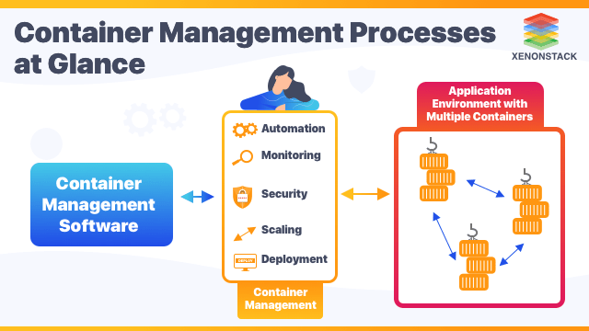
Why Container Management and Orchestration?
Ease of setup - Storage, security tools, schedulers, monitoring systems, reducing hosting setup complexities.
Simplified administration – Centralized management of configuration and secrets, Less time and resources needed for DevOps processes.
Automation – Networking, Load balancing, scheduling deployments, autoscaling, Continuous health checks.
Extensible – Extend functionality using Add-Ons or plugins.

Slide 5
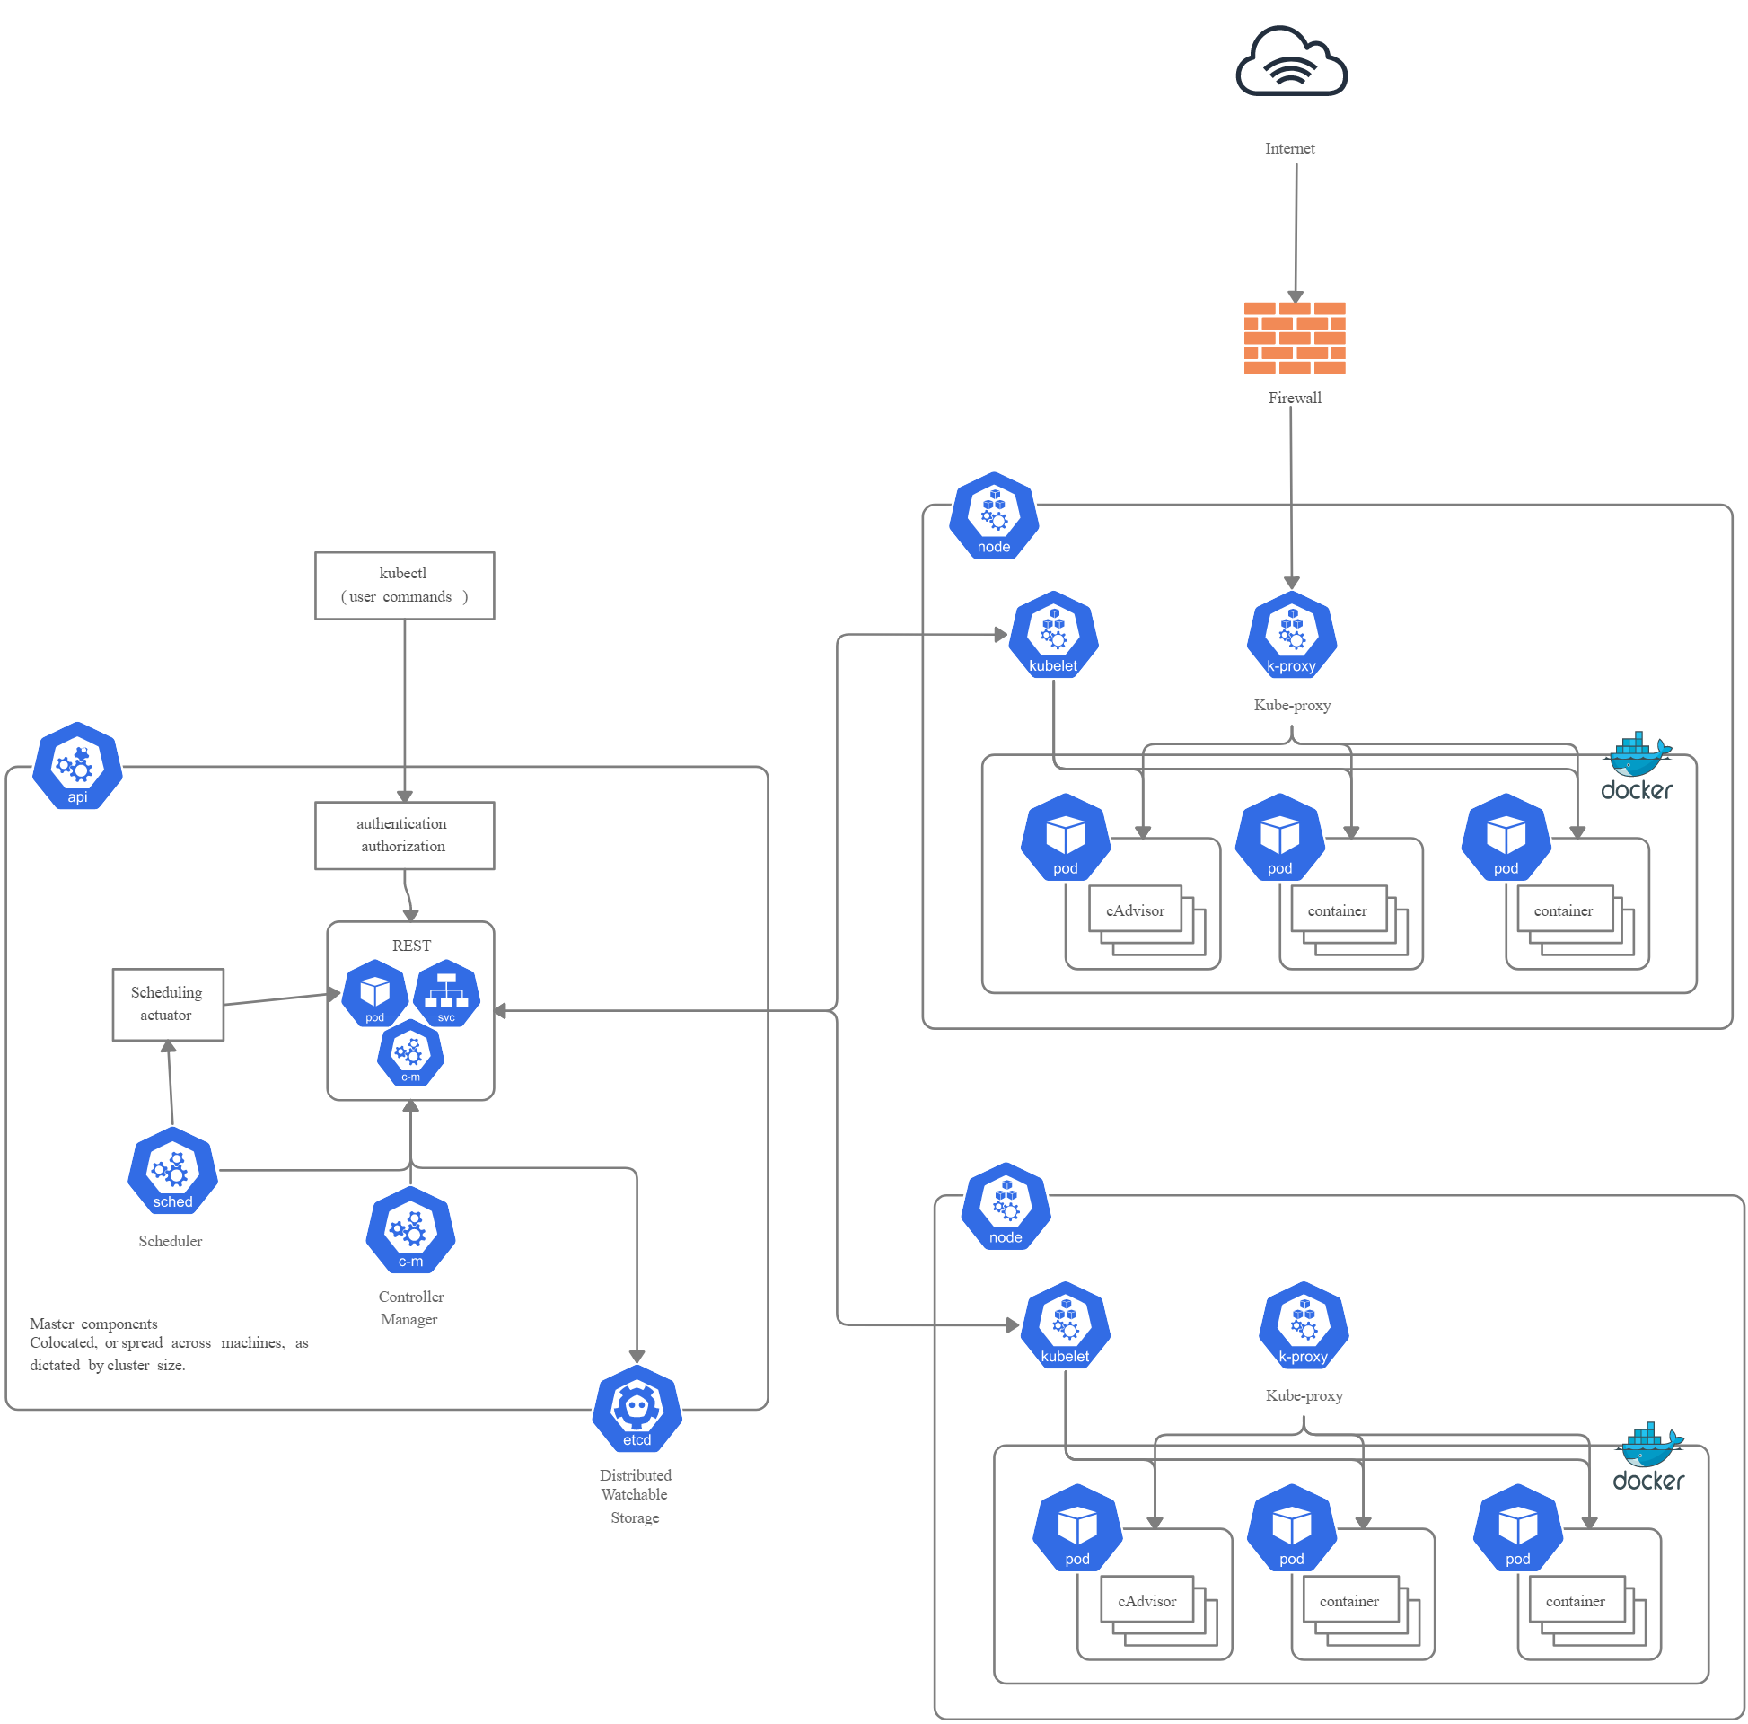
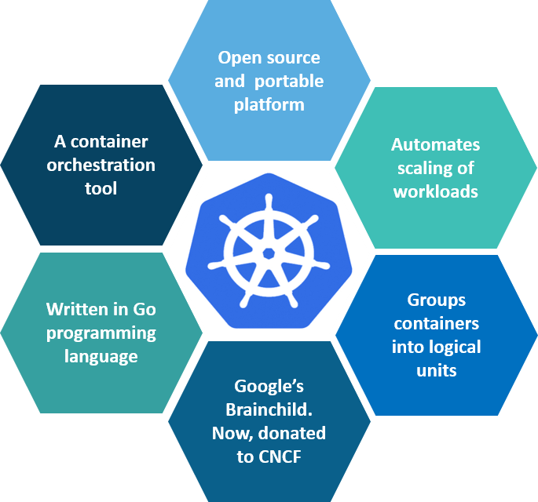
KUBERNETES
What is Kubernetes?
Kubernetes is an open-source container management (orchestration) tool. It’s container management responsibilities include container deployment, scaling & descaling of containers & container load balancing.
Key features:

Slide 6
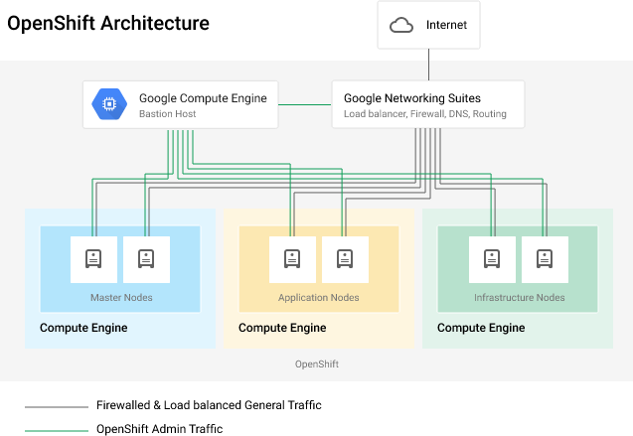
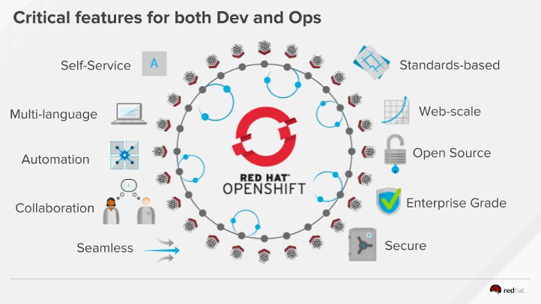
Red Hat OpenShift
What is Red Hat OpenShift?
OpenShift is a family of containerization software products developed by Red Hat. Its flagship product is the OpenShift Container Platform — a hybrid cloud platform as a service built around Linux containers orchestrated and managed by Kubernetes on a foundation of Red Hat Enterprise Linux.

Slide 7
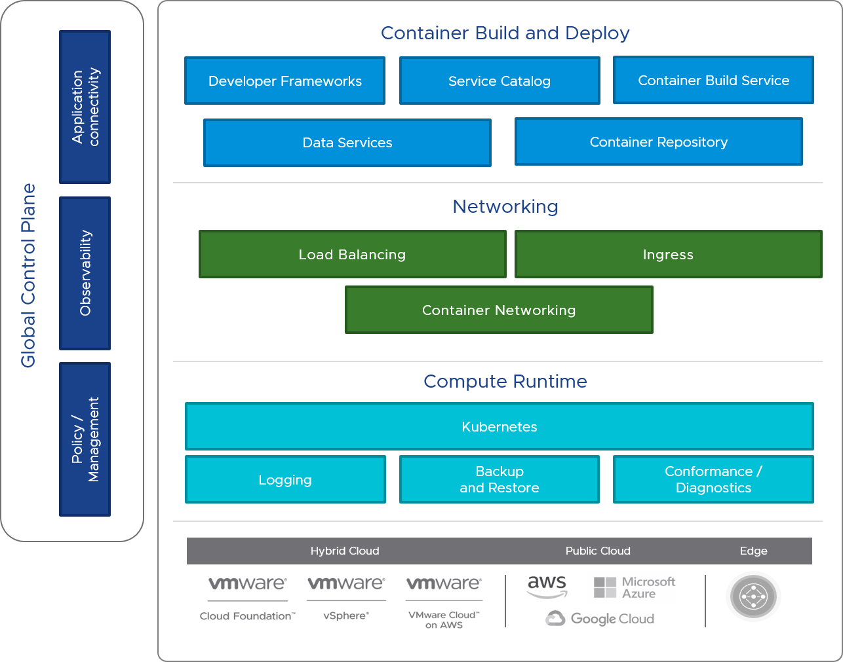
VMware Tanzu
What is VMware Tanzu?
VMware Tanzu is the suite or portfolio of products and solutions that allow its customers to Build, Run, and Manage Kubernetes controlled container-based applications.
Key Features:
Centralized Kubernetes Lifecycle Management
Unified Access Management
Security and Configuration Management
Backup and Restores with Velero(Backup).

Slide 8
Table of Comparison
This shows the comparison between the 3 platforms
Kubernetes:
Provides flexibility to deploy to any platform
It has command line interface
There is no native image repositories
It has no native networking solution
Additional functionality is through add-on(Third party plugins).
No built in disaster recovery solution.
It is licensed under Apache 2.0(open source). Project under CNCF
Kubernetes is free. Paid support from third party or partners.
Red Hat OpenShift:
It is tightly integrated with Red Hat
Provides more security
It is a Commercial platform
Has a built in GUI.
It has native image repositories
Has its own networking solution (open-v-switch)
Native monitoring tools
Preferred for on-prem environment
Subscription based, socket and core based. Hourly pricing on cloud providers. Red Hat Openshift pricing
VMware Tanzu:
Container build automation
Full stack observability
Has cloud compatibility
It has native monitoring and management tools
Has built in GUI
Automated processes
Different Operating systems are supported
VMware uses Per CPU licensing.
All the 3 platforms require usage of third party plugins for Disaster Recovery since none of them have built in DR features.

Slide 9
Thank You.
Shreyas B Rao
9632264435
chechu301001@gmail.com
https://www.linkedin.com/in/shreyas-b-rao-360296206/

